Slide 1
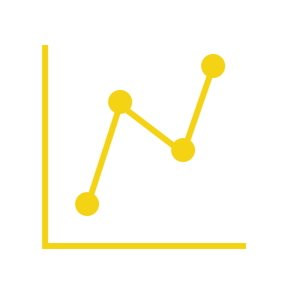

DEVELOPERS TRENDS
TRANSFORMATION

Slide 2
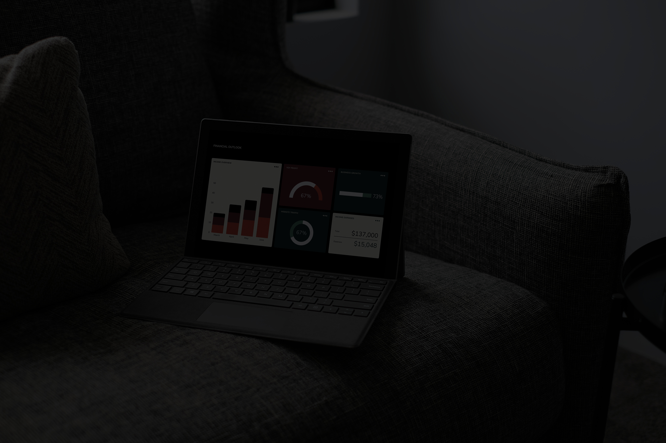


PROBLEM STATEMENT
With significant changes in remote work, tooling preferences, and AI adoption, the developer work environment is changing quickly. However, businesses and tech executives frequently don't have a clear understanding of how these trends have evolved over time.

Slide 3

Track changes in remote work trends over the years and their correlation with global shifts.Compare popularity of databases, platforms, IDEs, and programming languages to understand developer tool preferences and emerging technologies.Analyze how developers are using AI tools—including their purpose, benefits, and most used AI search tools.Identify patterns and shifts across years to forecast where developer practices might be heading.Support decision-makers (e.g., educators, tool makers, team leads) with actionable insights.
AIM
Track changes in remote work trends over the years
Compare popularity of databases, platforms, and programming languages to understand developer tool preferences and emerging technologies
Analyze how developers are using AI tools including their purpose, benefits, and most used AI search tools
Support decision-makers to identify Market Salary

Slide 4


DATA OVERVIEW
5 Datasets
375K
32yrs
TIME FRAME
NUMBER OF PARTICIPANTS
AVG AGE
Years Covered in the Dataset (2020–2024)
Total Number of Participants from 2020-2024
Average Age of Participants Throughout The Years

Slide 5
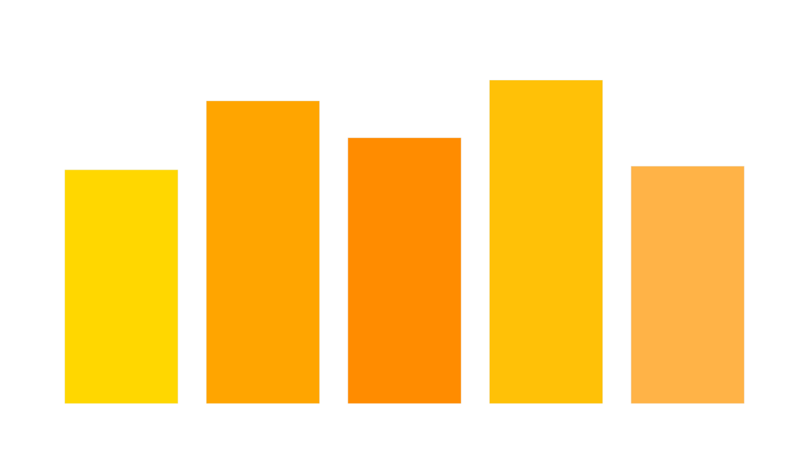
NUMBER OF PARTICIPANTS

Slide 6
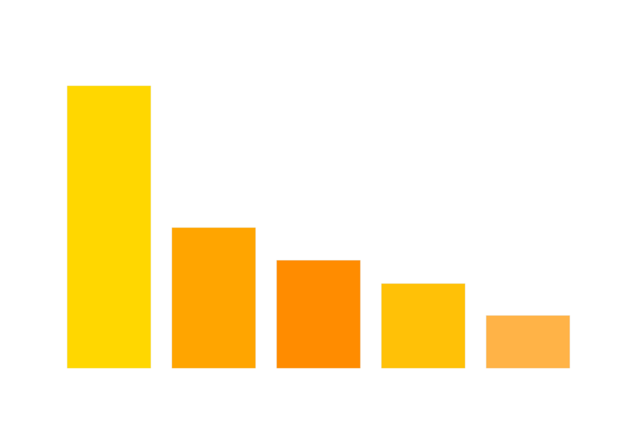
DEMOGRAPHIC
Notes:
Change the color | remove the legened | reason why I am using the age | charts: Clean, mention one number | Split entire Analysis to 4-5 Topics | create a story to decide what to the main topic | 1:am I in the right age point, what database I need to be familiar with, frame the whole data to the story

Slide 7
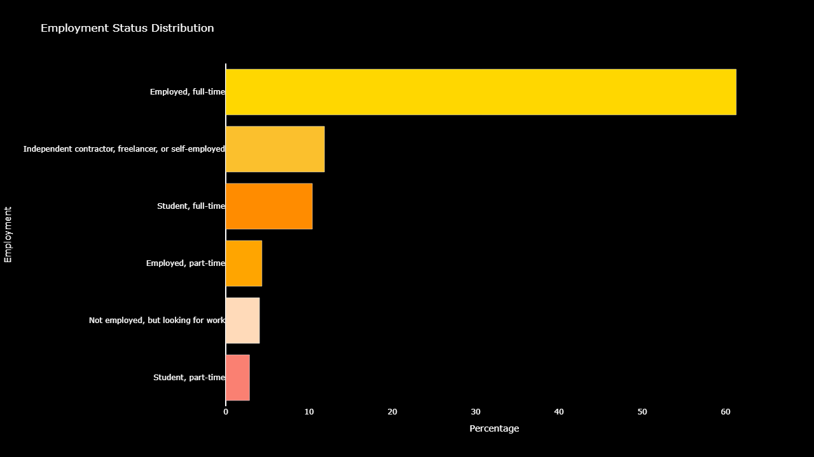
EMPLOYMENT STATUS

Slide 8

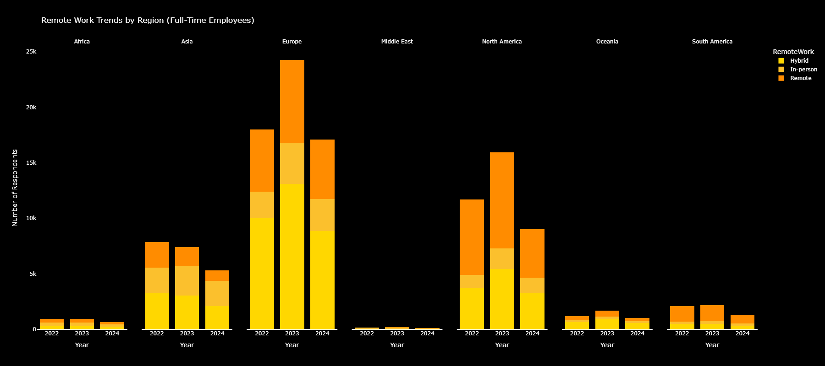
REMOTE WORK
This graph shows that Hybrid Work Status is dominant in Europe Region followed by Remote Work
Notes:
The line chart isn’t that good and change the color (change the line chart (Stacked Bar Chart) option and change the color), mention that middle east is too small unable to create the analysis

Slide 9
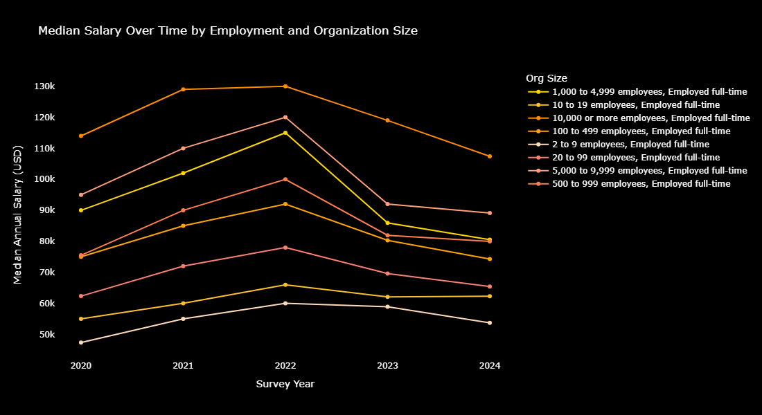
SALARY TREND
This graph shows that 2022 is the Salary peak across all years
Notes:
The line chart isn’t that good and change the color (change the line chart (Stacked Bar Chart) option and change the color), mention that middle east is too small unable to create the analysis

Slide 10
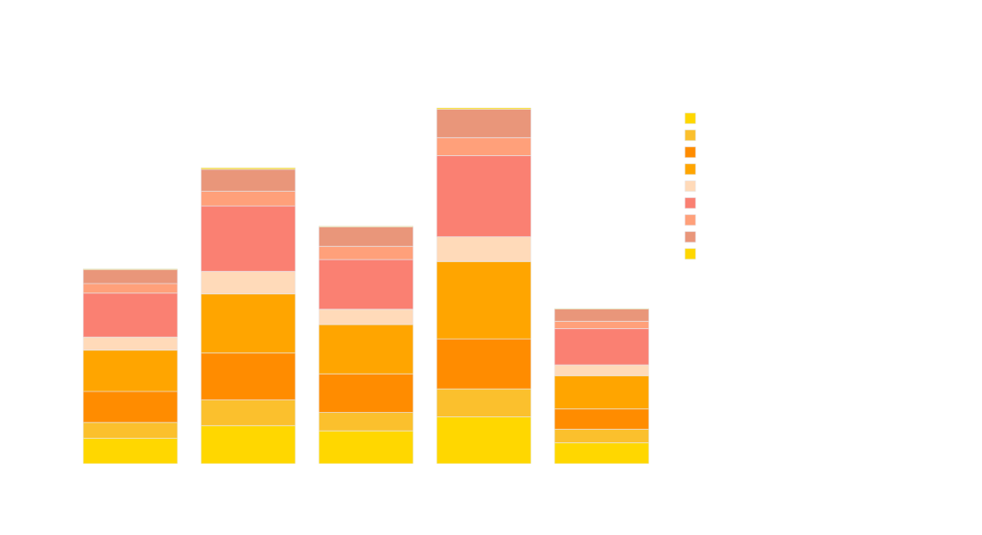
SALARY TREND
This graph shows that 20 to 99 employees company size across all years is the dominant in the number of respondents
Notes:
The line chart isn’t that good and change the color (change the line chart (Stacked Bar Chart) option and change the color), mention that middle east is too small unable to create the analysis

Slide 11
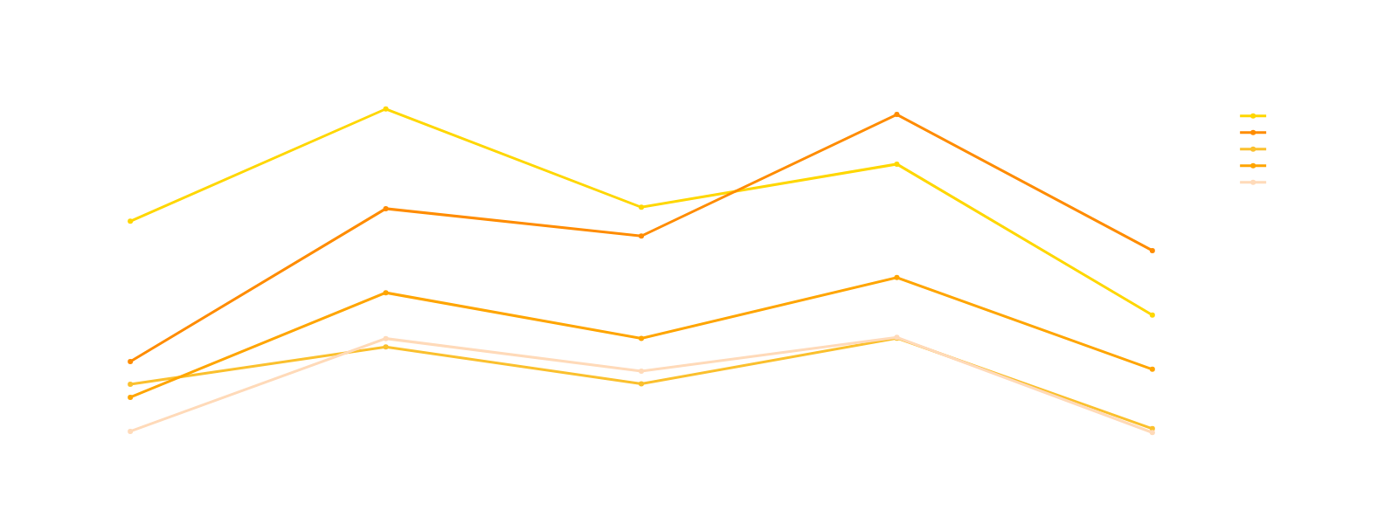
DATABASE
This graph shows a peak in 2023 for all the database that the developers works with in the line of work, it also highlights PostgreSQL as the most used Database in in 2023 & 2024
The graph gives a clear understanding that most companies prefer using SQL for their Database

Slide 12
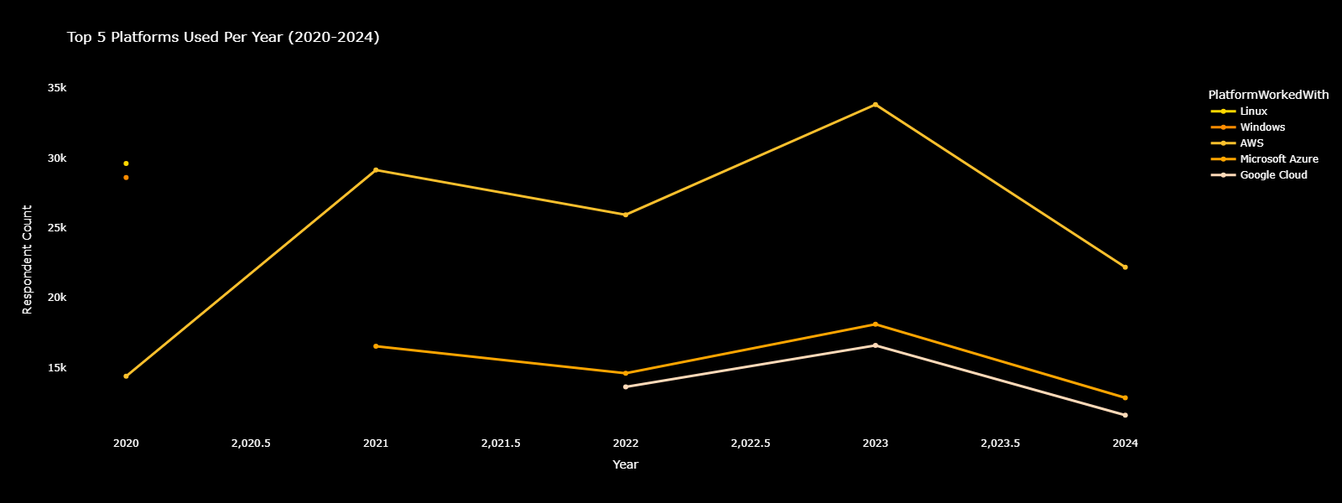
PLATFORM
This graph shows the most used Cloud platform across all years is Amazon Web Services (AWS) and Google Cloud started gaining recognition in 2022 and maintained having users until 2024

Slide 13
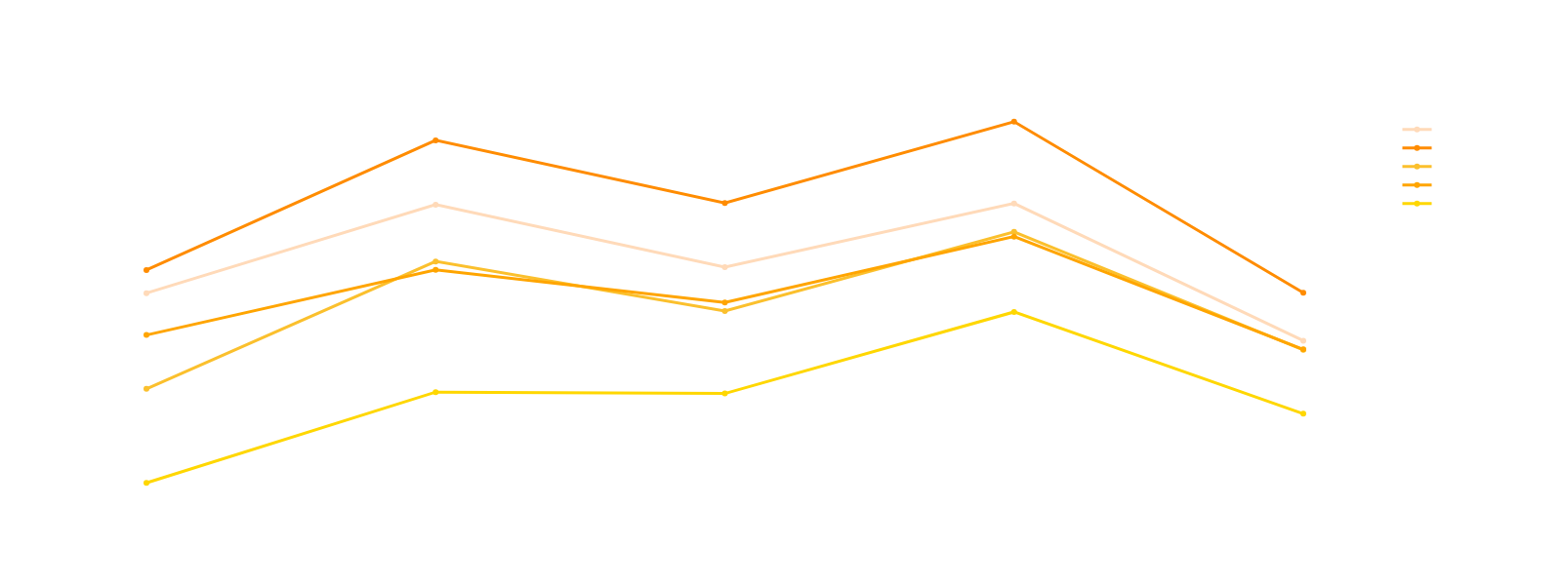
PROGRAMMING LANGUAGE
This graph shows that JavaScript is the most used Programming Language across all years, but it also highlights a comparable use for Python and SQL

Slide 14

AI USAGE
This graph shows that a difference in the years for AI Usage due to less participants in 2024, however, the usage of AI by developers remained the highest

Slide 15
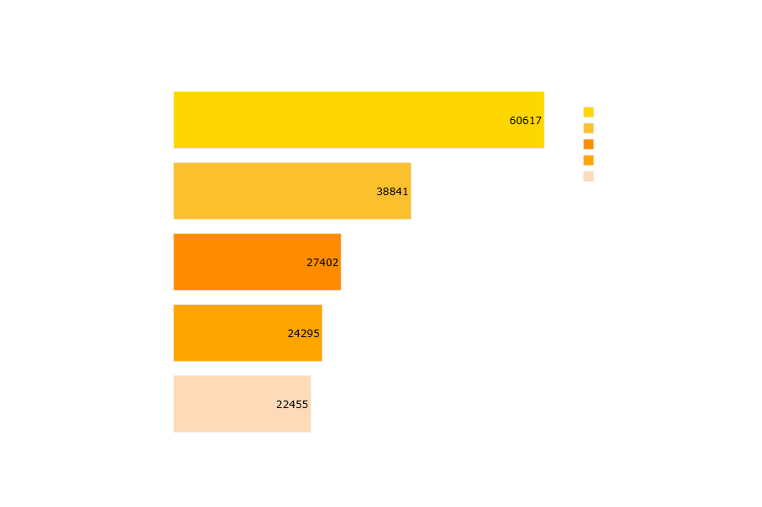
AI TOOL
This graph shows that many Participants Uses AI for Code Writing and Debugging

Slide 16
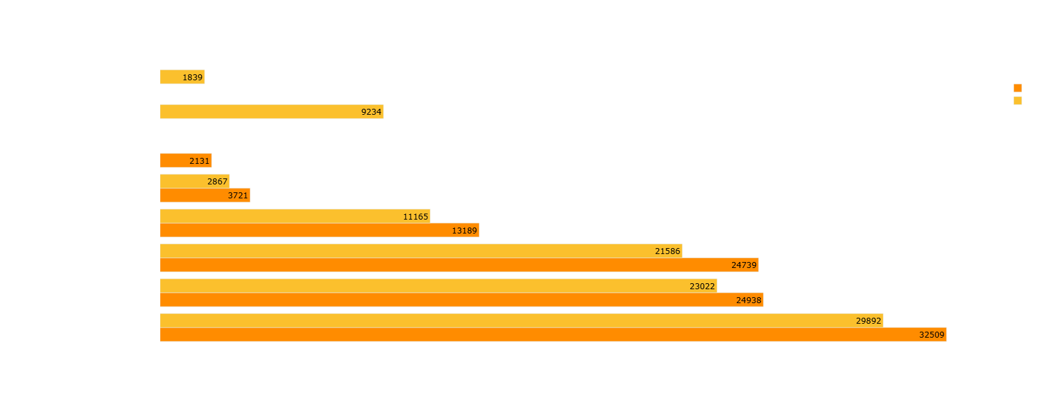
AI BENEFIT
This graph shows that many Participants see that AI increases their Productivity and their Learning Speed in both years (2023 & 2024)

Slide 17
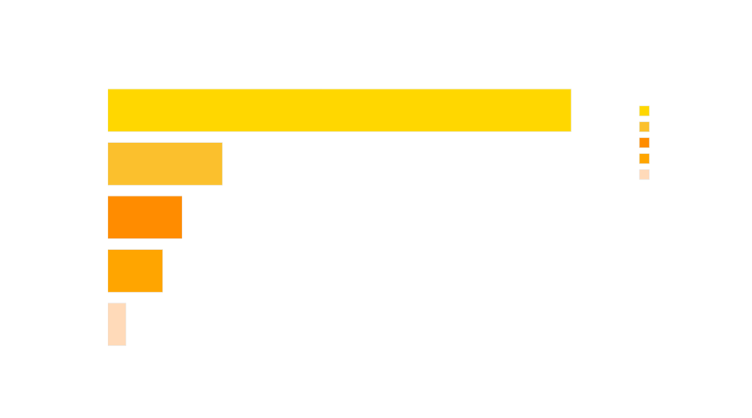
AI SEARCH TOOL
This graph shows that many Participants relay on ChatGPT

Slide 18
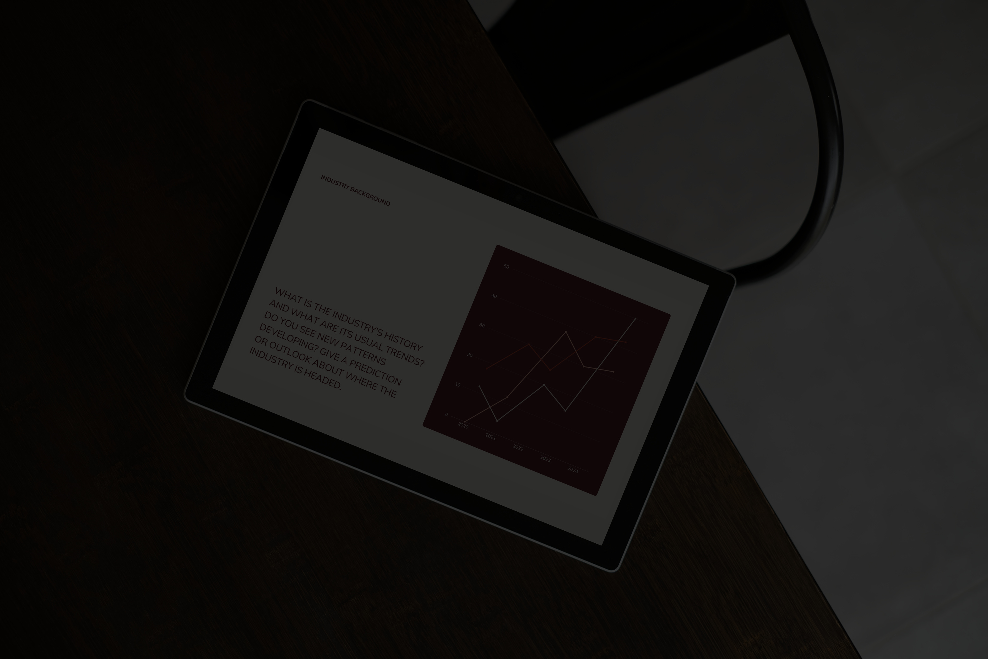
CONCLUSION
Remote work has become normalized, where it shows that companies value the Work-Life Balance of their Employees in Europe followed by U.S
Tool Preferences from programming languages and databases continue to evolve, shaped by performance, community, and modern use cases
AI adoption is accelerating, with more developers using AI tools for learning, coding, and productivity
These insights highlight the need for companies, educators, and platform developers to adapt to these trends, ensuring they stay relevant, efficient, and aligned with how developers work.

Slide 19


RECOMMENDATION
Since AI greatly impacts productivity, large companies should build their own AI systems to protect sensitive data and monitor staff behavior around data use
AI Benefit:
Programming Language:
Future Developers should have the foundation of JavaScript & HTML Languages in addition to SQL

Slide 20
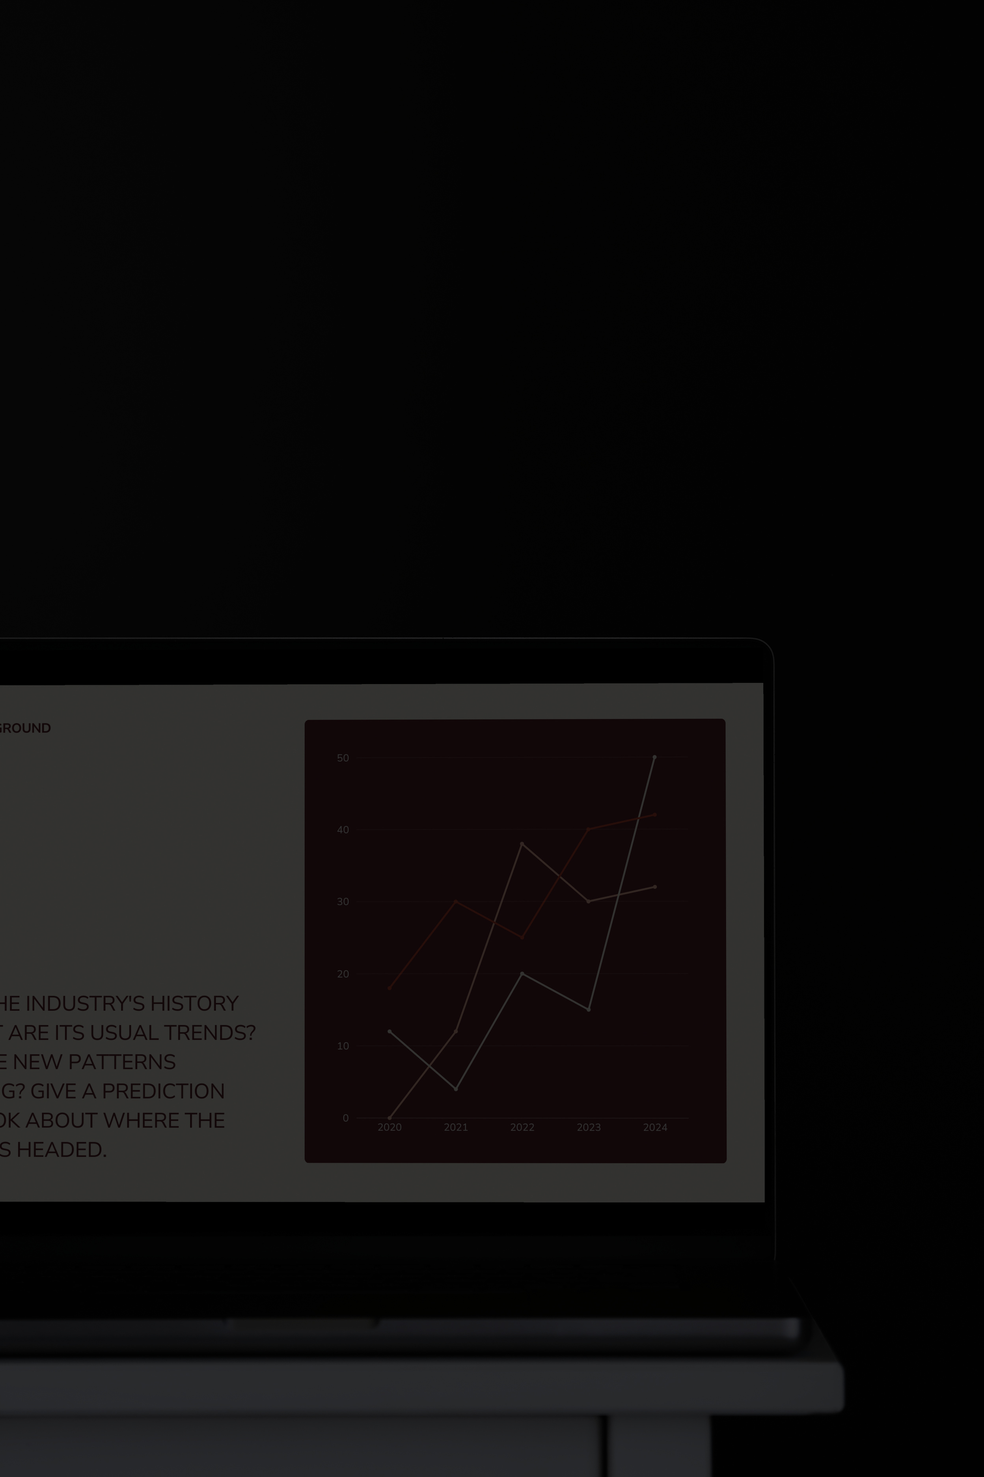

I WANT TO SAY
THANK YOU
FOR YOUR ATTENTION

